Slide 1


Social Buzz

Slide 2


Today's agenda
Project recap
Problem
The Analytics team
Process
Insights
Summary

Slide 3

Project Recap
Social Buzz is a technology company that is growing
faster than anticipated and needs help
overseeing their scaling process effectively.
Accenture is running a 3 month initial project
that will provide Social Buzz with the following:
An audit of their big data practices
Recommendations for a successful IPO
An analysis that highlights the top 5
categories with the largest aggregate
popularity.

Slide 4

Client has reached a massive scale
in recent years and does not have
the resources internally
to manage and maintain the scaling
process.
Analysis that highlights the top 5 categories with
the largest aggregate popularity.
Problem

Slide 5



Fffkfjjhjfhhfhhh MY
Myself
Data Analyst
The Analytics team
Marcus Rompton
Senior Principle
Andrew Fleming
Chief Technical Architect

Slide 6
Data Exploration
Process
1
2
Data Cleaning
3
Data Modelling
4
Data Analysis
5
Insights

Slide 7

Insights
There are 1897 reactions to the most popular category
January is the month with
the most posts
16 Unique Categories

Slide 8
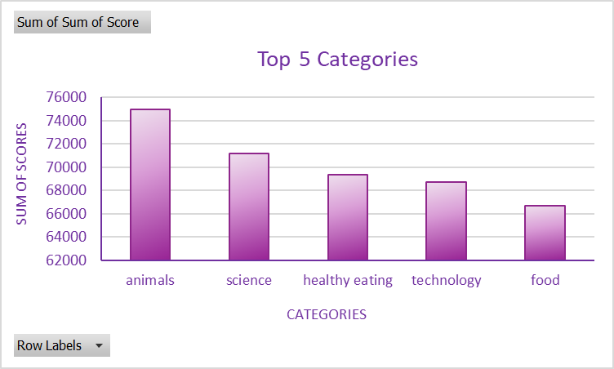

Slide 9
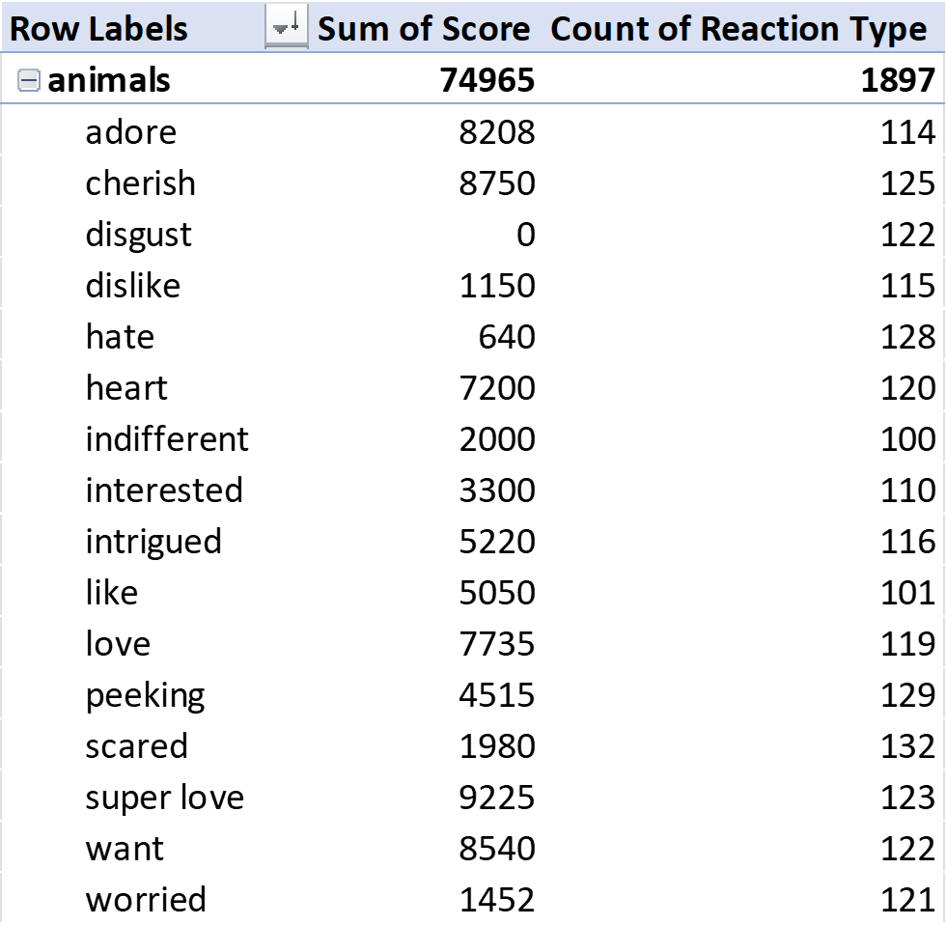

Slide 10

Analysis
Animals is top the 1 category which means that the vast majority of your audience may be animal lovers or they
enjoy being connected to the natural world.
Insights
Science is the second most popular category but Education is in the bottom 7 in terms of popularity. This could be because science content is more visual. You could find a way to make Education content more fun and visual.
Summary

Slide 11
Thank you!
ANY QUESTIONS?

